Slide 1
Gesture-based Text Entry Interface
Ellen Lo and Jamie Nelson
Boston University - Computer Science
December 7th 2018

Slide 2

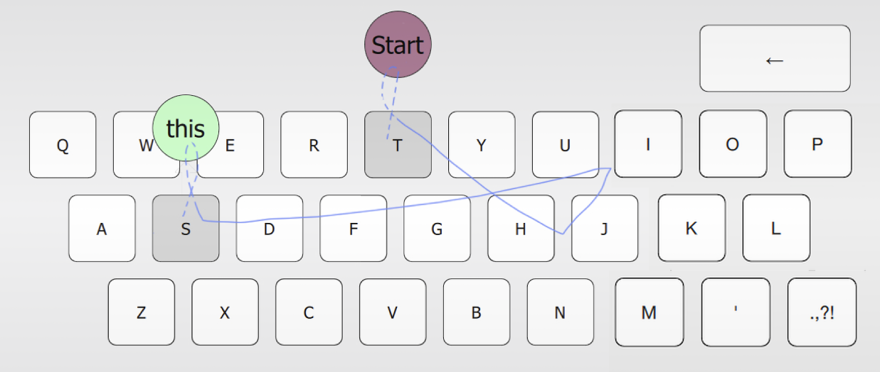
Motivation
Making computer vision accessible within browser
Moving away from traditional text entry via keyboard, like EyeSwipe
Hence, OpenCV.js!
Teachable Machine, Google Creative Lab, 2017
EyeSwipe: Dwell-free Text Entry Using Gaze Paths,
Kurauchi, Feng, Joshi, Morimoto, and Betke, 2016

Slide 3
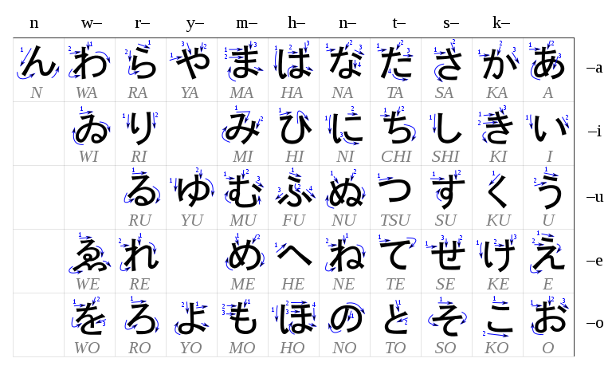
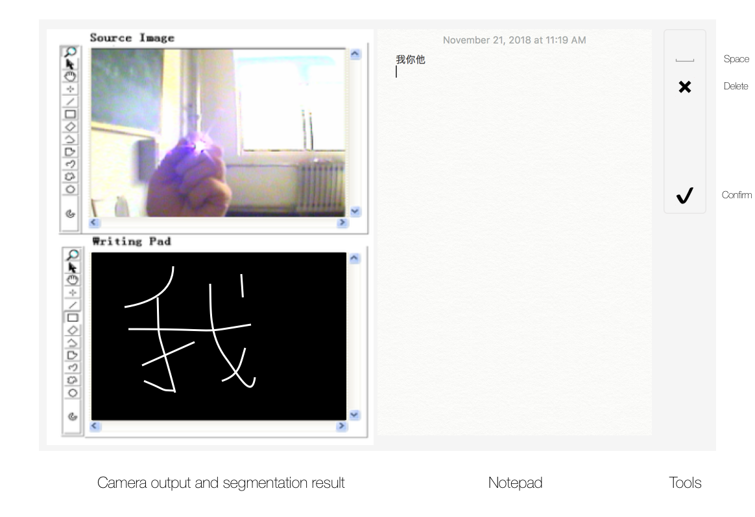
Problem Definition
Our goal is to track the pen light in the video frames and draw the letter on the canvas
Next, we use that image to recognize the Japanese character
This is more challenging than English characters because Japanese letters have more segmented sections
Hiragana
Desired output
Notes:
Specific goal of the project (Give a problem definition. Why is this an interesting and difficult problem?)
Heara- ganna

Slide 4
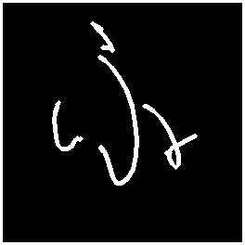
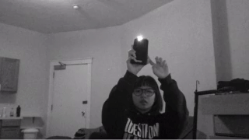

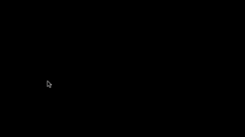
Methods for Segmentation and Tracking of the light
Camera input
Brightness thresholding +
largest
blob
Detect swipe with acceleration spikes
Segment ROI with centroid + bounding box
Camera input
Segmentation
Character path
Notes:
Take camera input
Detect bright regions and find largest blob with findContours function
Detect fast swipe movement by tracking acceleration of mirrored centroid of bright region
Upon swipe, find centroid, bounding box of character and use it as input for the classification

Slide 5
Methods for Letter Classification
We implemented supervised learning using a Neural Network
We used data found on github at https://github.com/inoueMashuu/hiragana-dataset
The training data included 50 hiragana characters; 20 samples each
Since this is a multiclass classification problem, we used one hot encoding
Notes:
Methods (based on material from class, the literature, or on your own ideas)
1000 images total.
Z, or the logit, is the summation of the inputs times the weights including a constant called the bias. (the sum is called the transfer function)
Our output is a function of Z (y = f(Z) or y = f(X * (dot product) W + b) ) where the function is the activation function
(dot product because X is a vector and W is a vector of the same size, we multiple each component and add the results aka the dot product)
most common activation functions: the sigmoid, the hyperbolic tangent and rectified linear unit
This is the artificial neuron.
A network combines these neurons. (feed forward neural network)
Softmax is e^z_j / sum of e^z_j for all values of j (this gives a probability to each value between 0 and 1 and all the probabilities sum to 1)
A good prediction will have the result = 1 and 0 for the rest of the values (one hot encoding)
Gradient descent is used to optimize the network
We chose a small learning rate ( the learning rate is the size of the step you take to improve the weights) each time you update the weights by subtracting the gradient (partial derivative)
Backpropagation - calculate the error then propagate the error backwards
We take the gradient of the error function with respect to the weights (the change in error given the current weights) and we do that for all layers of weights
The goal is the decrease the error (local min of the error function) - for an optimal network
For the loss function you can use Mean Square Error (the sum of the difference squared divided by the total number of outputs)
or Cross Entropy ( - sum ( p(x) log( q(x) ) ) ) where p(x) is true labels and q(x) is the predicted

Slide 6
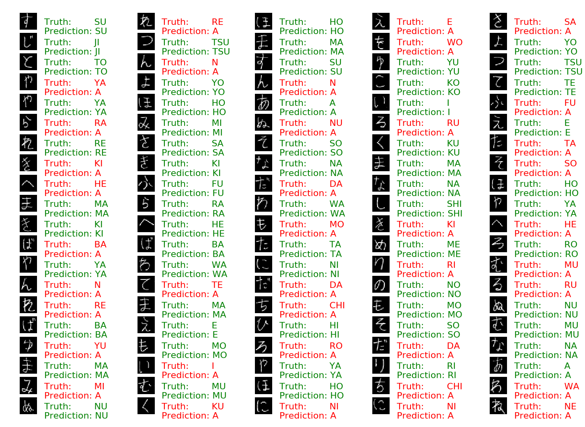
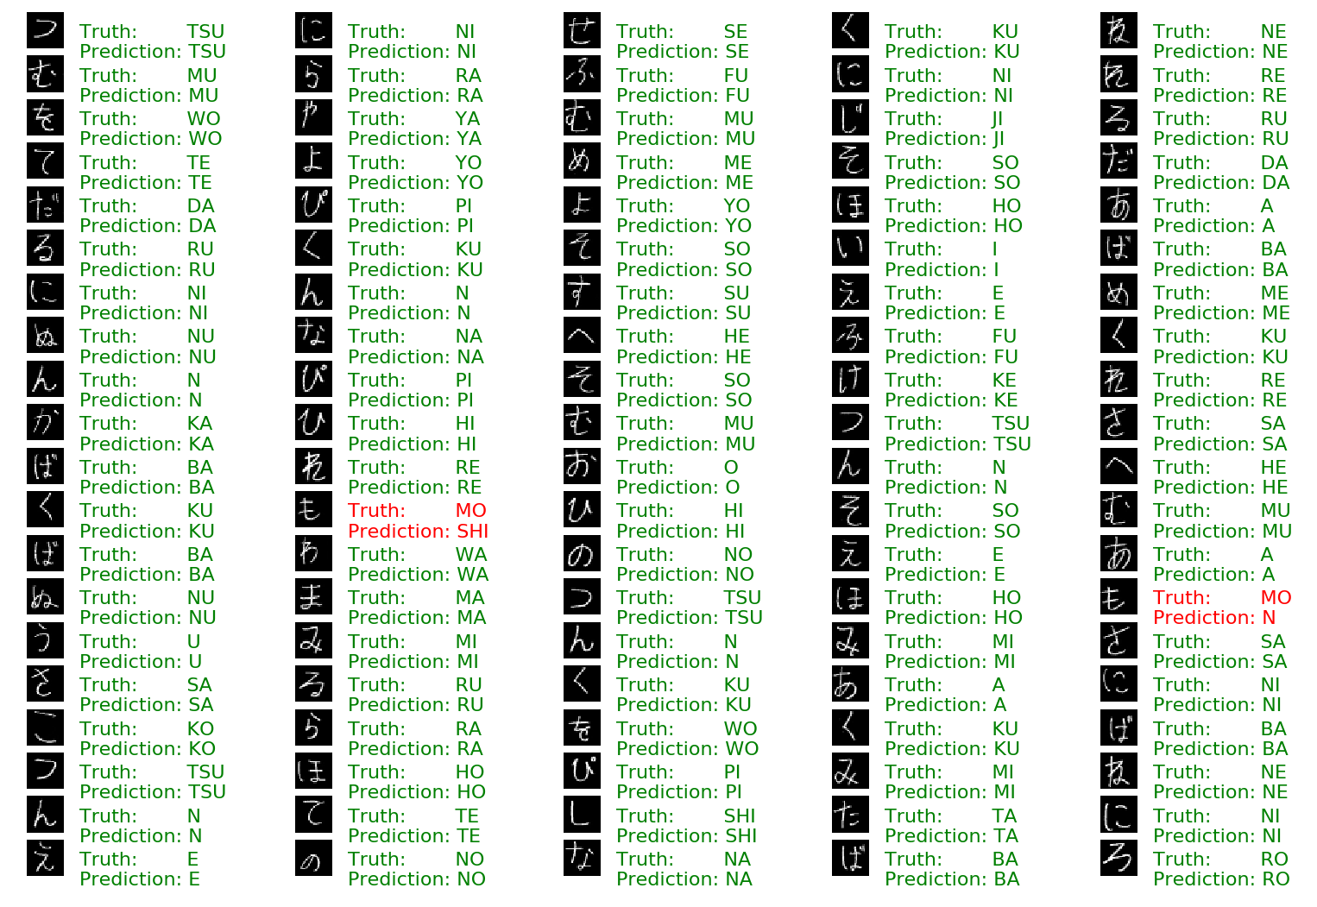
Methods For Classification
First version
Second version
Notes:
Experiments
I used a feed forward neural network at first. I tried using 28 by 28 size images and a fully connected layer with the relu activation function. I used softmax cross entropy as the loss function and the adam optimizer with a learning rate of 0.001 to predict the results. I also used 201 EPOCHs or steps in the training process. (EPOCH is one forward pass and one back pass for all the training examples and the batch size is the number of training examples in one forward/backward pass)
The first experiments I ran on the neural network I didn’t normalize the image values so I got really bad results. I trained the network on all the data and picked 1000 random samples of the dataset. (which I know now is bad practice due to overfitting). That was accurate 50% of the time.
Next, I tried the same network but with normalized images or dividing the image values by 255 to have a range between 0 and 1. I believe the helps in the optimization step. It is easier to take steps in gradient descent. This created 98% accuracy when testing with samples from the dataset.

Slide 7
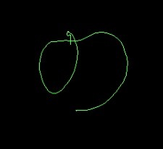
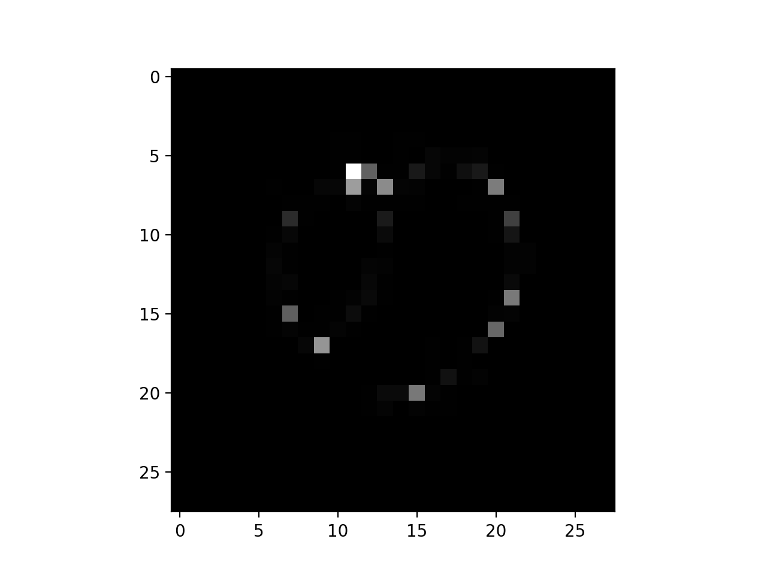
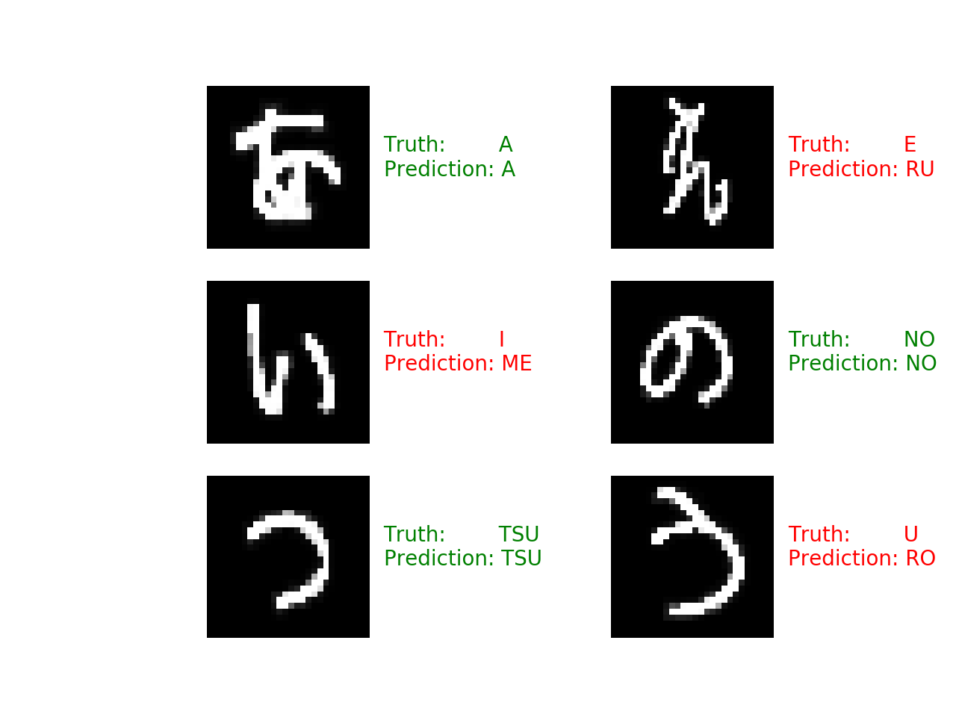
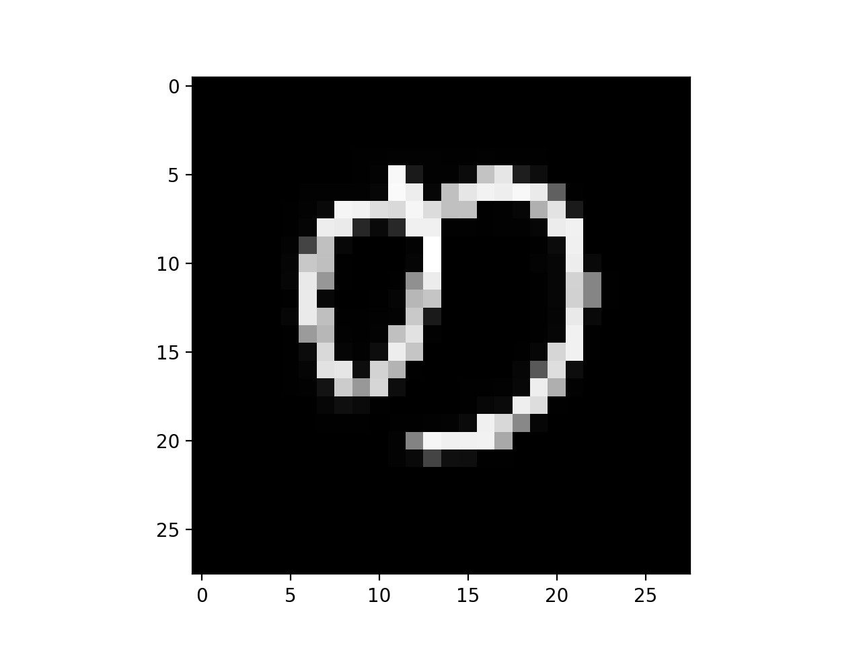
Experiments
Notes:
Then, we introduced some of the image results from the segmentation. (distractors) First, there were problems due to the line size. So first for the images I had to perform dilation to expand the line width of the letters. I used a 9 by 9 kernel of all 1s.
This gave a 50% accuracy rate. I was training on all the data and also testing using the same images. This caused overfitting. Also, the model was extremely simple. So I looked for ways to improve it like deepening the network, making it a convolutional neural network with max pooling and drop out. I used 2 conv layers with 5 by 5 filters and a dropout probability of 0.5. I also increased the image size to 32 by 32 to see if that enhanced the accuracy.

Slide 8
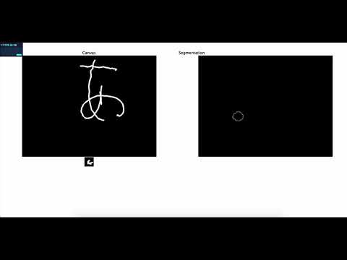
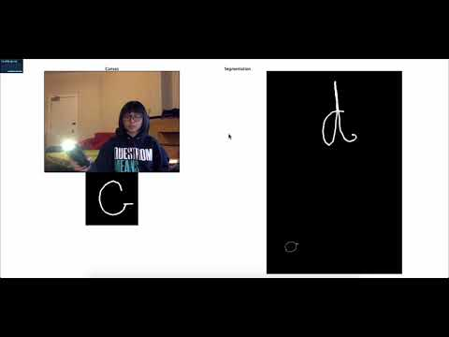
Results
Japanese (hiragana)
English
Notes:
Japanese: 2 characters
English: 7 characters in 30 seconds

Slide 9
Discussion
Machine learning
If we had more data of Japanese letters, then the model for classification would possibly improve
Also, training the convolutional neural network under better conditions could yield better results
https://project-cs585.herokuapp.com
Computer vision
Challenging to write more segmented characters in air
=> compare speed of English and Japanese
Difficult to locate discontinuous strokes => mimic transparent glass blackboard by overlaying character path on camera input
Auto-removal of ending of character path due to swipe gesture
Add gestures for deletion, spacing
Notes:
Discussion of results (Is the method successful? Are your results satisfactory? What are the limitations of the method used? Did you improve on the state-of-the-art? Give a critical evaluation.)
(1 out 50 chance or (0.02; 2%) probability by just randomly guessing the letter) and accuracy results with our implementation)

Slide 10
Conclusions
Notes:
Conclusions.
Thank you for listening

